Slide 1

AGILE METHODOLOGIES
EXPLORING THE METHODOLOGIES

Slide 2

SCRUM
THE KEY FEATURES
Sprint
Sprint Planning
Daily scrum meeting
Sprint review
Sprint retrospective

Slide 3
SCRUM ADVANTAGES
Flexibility and adaptability
Creativity and Innovation
Time to task
Lower costs and Improved quality
Improved customer satisfaction

Slide 4
SCRUM DISADVANTAGES
Training and skill required
Organizational Transformation
Scalability
Integration with project/program management

Slide 5
Key People
Product Owner
Scrum Master
Team

Slide 6
When to implement one or the other
SPRINT PROCESS IN CHRONOLOGICAL ORDER
Sprint Planning
Sprint Retrospective
Daily Scrum Meeting
Sprint Review
Sprint

Slide 7
FEATURE DRIVEN DEVELOPMENT (FDD)
KEY FEATURES
Develop an overall model
Build a features list
Plan by feature
Design by feature
Build by feature

Slide 8
ADVANTAGES OF FDD
Adaptive to changing environment (Flexible)
FDD ensures customer satisfaction through active involvement of users.
Least documentation
Reduces risks of development since reviews are done regularly

Slide 9
DISADVANTAGES OF FDD
So if the customer representative is not clear about the product features, the development process will go out of the track.
Lack of documentation can be a disadvantage if some new members join in the middle of the launch.
Time consuming and wastage of resources because of constant change of requirements
More helpful for management than developer than developers who have to cope with ever changing requirements

Slide 10
KEY PEOPLE
Project Manager
Programming Team

Slide 11
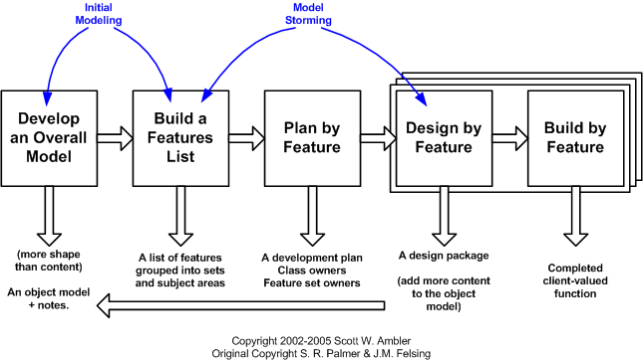
When to implement one or the other

